Slide 1
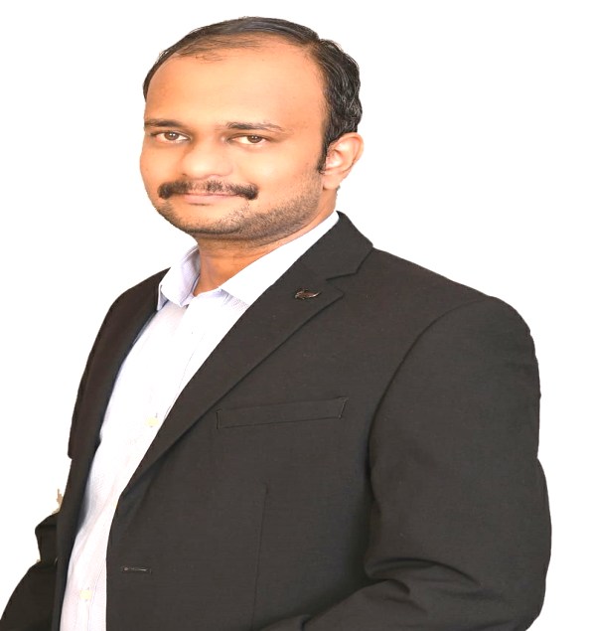

2
Founder’s Message
Balaji Murali
Founder
Finari Services strives to accelerate its banking & software business with a profound understanding of the client’s requirement and needs.
Our Client challenges are treated with utmost
respect and sincerity, as we work diligently to exceed or meet their expectations.

Slide 2


3
About Us
Finari Services Pvt Ltd was incorporated in June 2021 with 30 years of cumulative experience of founders in core banking domain. We offer consulting & services in core banking package software and web technology domains project.
In today’s financial ecosystem for bridging business and technology, there comes a need for a techno functional consultants and Finari Services are specialized in it.
We support our clients right from the budding stage of their idea and support them throughout their journey. We focus on delivering revenue growth and improving the operational efficiency of our clients.

Slide 3




6
Our Services
Our services
We work on requirement elicitation, software design, customization, Go Live release support, production support, Manual testing, automated testing, chair UAT, release upgrade and system performance tuning projects.
Core Banking
Web Technology
We provide consulting and services on core banking package software AVALOQ .
We support small and mid level organizations on their digital transformation E2E.

Slide 4
8
Services offered in detail
✓
Avaloq
Implementation of new booking center.
Implementation of new / enhancements on functional modules, reports and Interfaces.
Release upgrade.
Production support.
Platform stabilization and performance tuning.
Build automation testing repository and upscale testing quality.
✓
Cloud Computing & Web Technology
Implementation of web components in multi stack.
Digital transformation
  Setup new infrastructure in cloud.
  Migrate existing physical infrastructure to cloud.

Slide 5




Thank You
Registered Address
Office Address
Telephone
Plot No 20, 2nd street,
Thirumagal Nagar,
Selaiyur (Post),
Chennai 600073,
Tamil Nadu.
STPI,
No.5 ,SH 49A,
Taramani,
Chennai 600113,
Tamil Nadu.
+91 98404 49446
Email
support@finariservices.com

